Slide 1
Ombuds Team
LOGO
Overview
Presenters: OMBUDS TEAM
DATE

Slide 2
Ombuds Team
Introductions

Slide 3
What does the
Ombuds Team do?

Slide 4
What the Ombuds Team Does and Doesn’t Do
The Ombuds Team Does:
The Ombuds Team Does Not:
Listen and serve as a sounding board
Explain process, policies, and procedures
Develop options
Evaluate options and strategies
Help people navigate other relevant resources at the Institute
Coaching on conflict and communication
Raise anonymized, systemic issues and trends to leadership
Receive official notice of claims against the organization
Share with whom they have spoken unless given explicit permission
Conduct investigations
Make management or policy decisions
Advocate for or take sides between individuals or groups
Maintain records

Slide 5
What makes the
Ombuds Team unique –
Standards of Practice

Slide 6
Standards of Practice & Code of Ethics
International Ombuds Association
Confidential
Impartial
Informal
Independent
All communications with the Ombuds Team are confidential to the maximum extent permitted by law, except when the Ombuds Team member determines there is an imminent risk of serious harm or if given explicit permission to share by the visitor.
The Ombuds Team does not take sides or advocate for individuals or groups but supports a fair process for all.
The Ombuds Team is an off-the-record resource and does not participate in formal reporting or investigation.
The Ombuds Team operates independently of the organization in structure, function, and appearance to the highest degree possible.

Slide 7
Reasons to Engage with the Ombuds
Communication challenges
Abrasive behavior
Unethical behavior
Microaggressions
Perceived unfair treatment
Perceived harassment/discrimination
Challenging group dynamics
Accusations against you
Fear of speaking up
Confusing/concerning processes or procedures
Questions about other Institute resources
Any other concern, big or small!

Slide 8
Identifying and Reporting Systemic Issues
Ombuds Team gathers information on issues
Information is secured, redacted, anonymized
Aggregated data is used to identify patterns, trends, and note-worthy areas of concern
Data is compiled into periodic reports and provided to senior leadership
Provides insight into systemic issues and actionable recommendations for systemic improvement

Slide 9
How does someone engage with the
Ombuds Team ?

Slide 10
Ways to Engage with the Ombuds Team
Confidential
Meeting
Informational
Presentation
Refer
Virtual
Phone, Email or Web form
Voluntary
Confidential
Overview
5-30 minutes

Slide 11
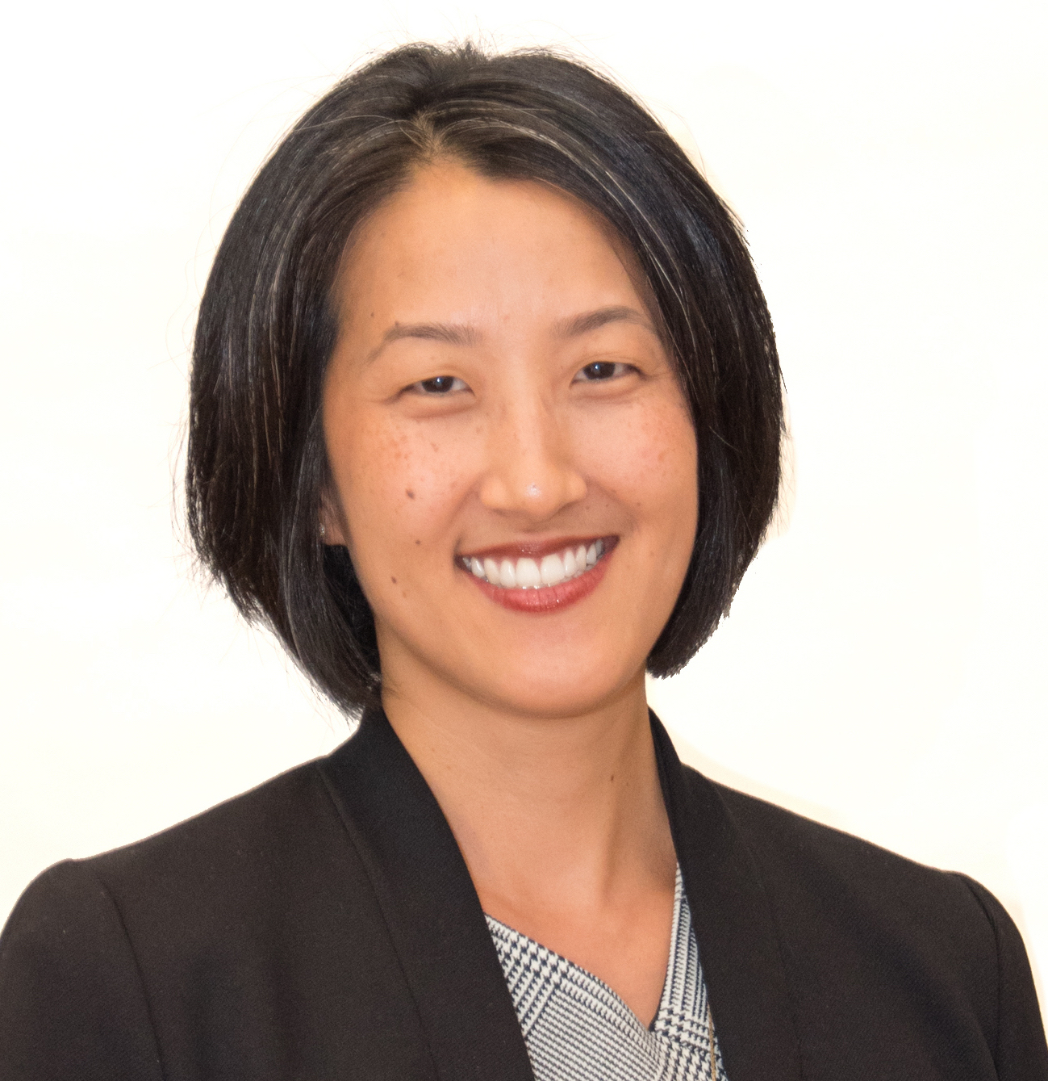
Your Ombuds Team
Ombuds 1
Bina Patel
Bina Patel
Ombuds 2
Ombuds 3
555-555-5555
ombuds@mwi.org
555-555-5555
ombuds@mwi.org
555-555-5555
ombuds@mwi.org
LINK TO WEBSITE

Slide 12
Q&A

